Slide 1
Computer Vision Project
Raymond Feng, Steven Salto

Slide 2
Converting from 2D image to 3D mesh
Project Overview:
To generate a 3D mesh to represent an object from a 2D image
Experiment with AI models
Learn about point clouds
Learn how to construct a mesh from the point cloud
Export results for further uses

Slide 3
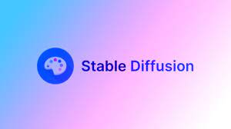
Stable Diffusion
Stable Diffusion is a deep learning, text-to-image model released in 2022 based on diffusion techniques. It is primarily used to generate detailed images conditioned on text descriptions.
Stable diffusion uses pre-trained models. Each model is trained on a specific set of images. This gives the model data to emulate which allows it to create high quality results especially after fine-tuning.

Slide 4

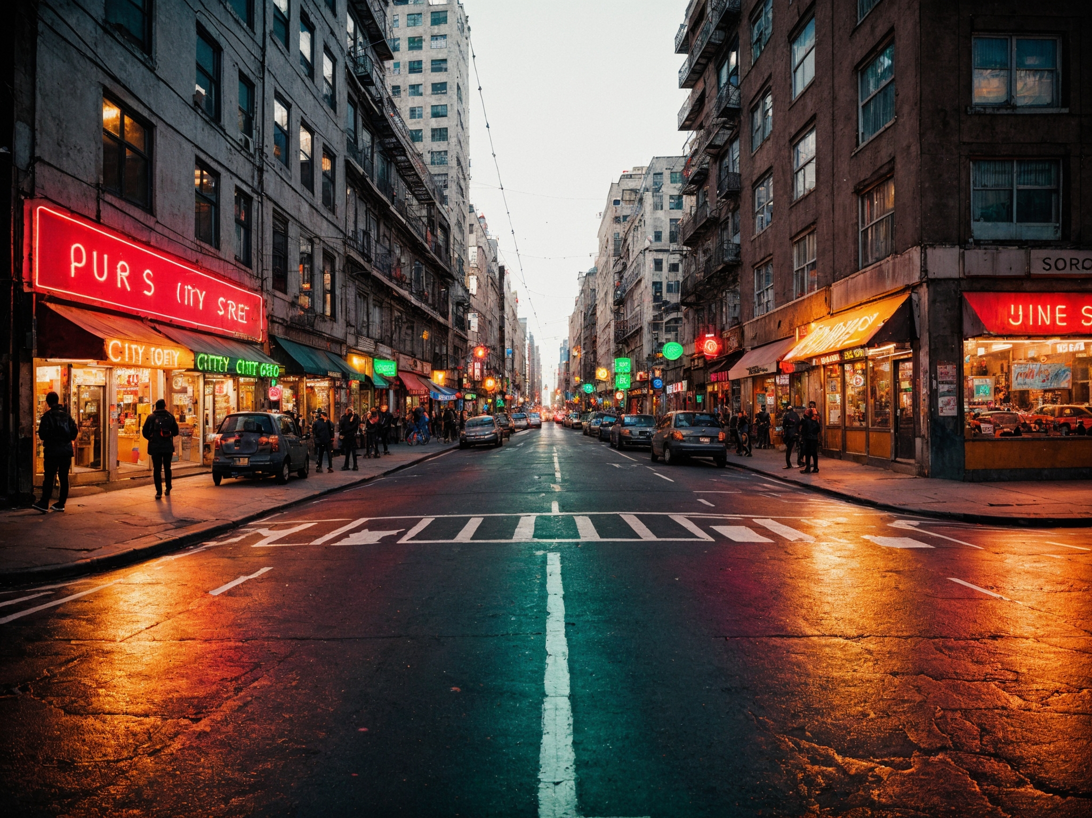
Model: Realistic Vision V6.0 B1
https://civitai.com/models/4201/realistic-vision-v60-b1

Slide 5
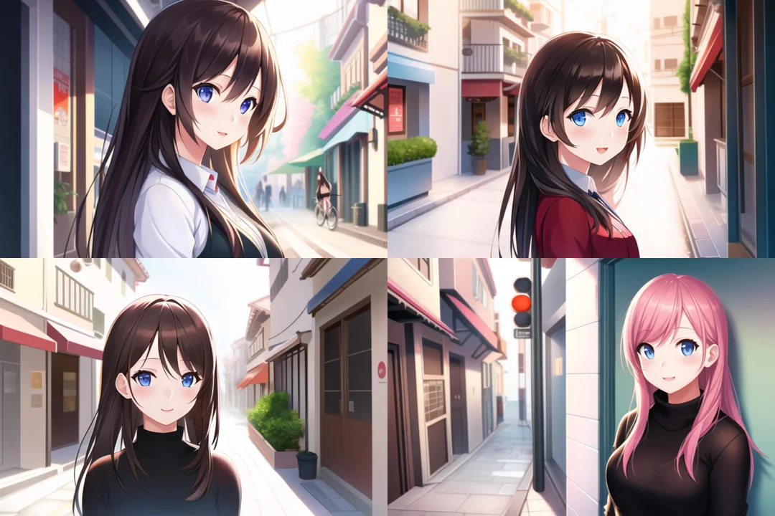
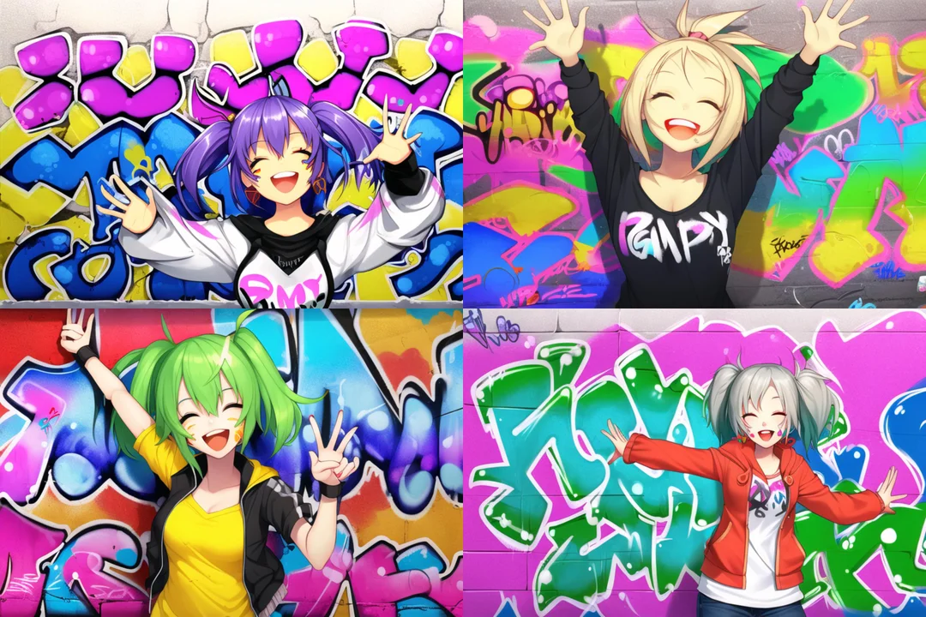
Model: Anything V3 (Anime)
https://civitai.com/models/66/anything-v3

Slide 6
Stable Diffusion
Webui:
https://github.com/AUTOMATIC1111/stable-diffusion-webui
CompVis:
https://github.com/CompVis/stable-diffusion
Online Generators/Resources:
https://civitai.com/
https://huggingface.co/spaces/stabilityai/stable-diffusion
https://stablediffusionweb.com/

Slide 7
Point Cloud and Mesh Generation
Point Clouds are generated using point_cloud = o3d.geometry.PointCloud() and point_cloud.points = o3d.utility.Vector3dVector(vertices), where vertices are determined by our cnn model.
An Open3D PointCloud object is created from these coordinates.
Normals are estimated for each point in the point cloud using the estimate_normals method. This is necessary for the Poisson surface reconstruction algorithm, which uses the normals to determine the orientation of the surface at each point.
The Poisson surface reconstruction algorithm is applied to the point cloud using the open3d.geometry.TriangleMesh.create_from_point_cloud_poisson method. This generates a 3D mesh from the point cloud.

Slide 8
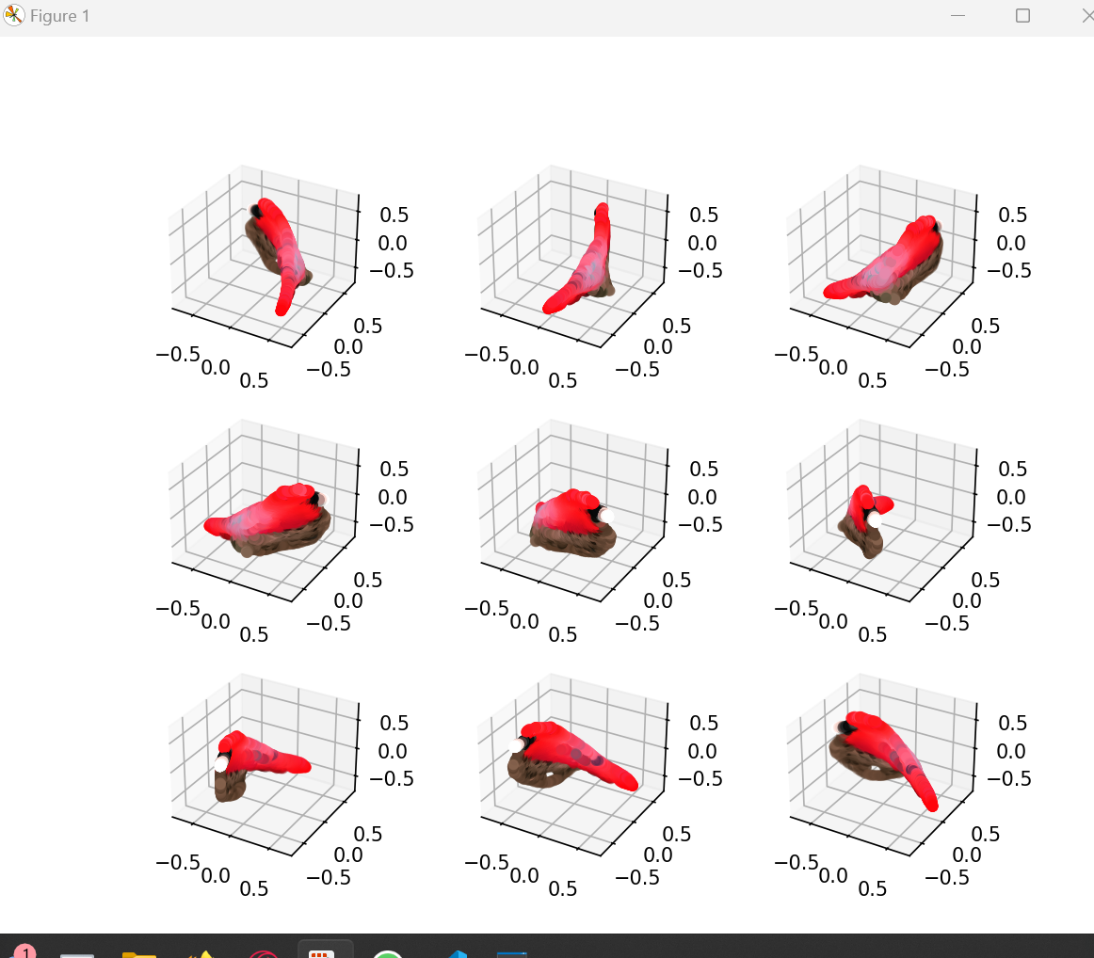
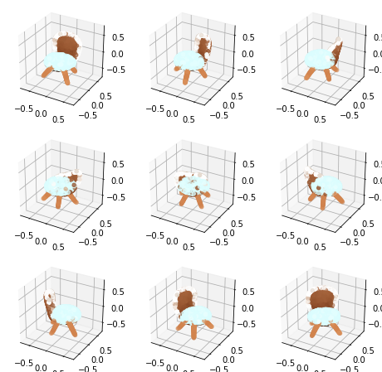
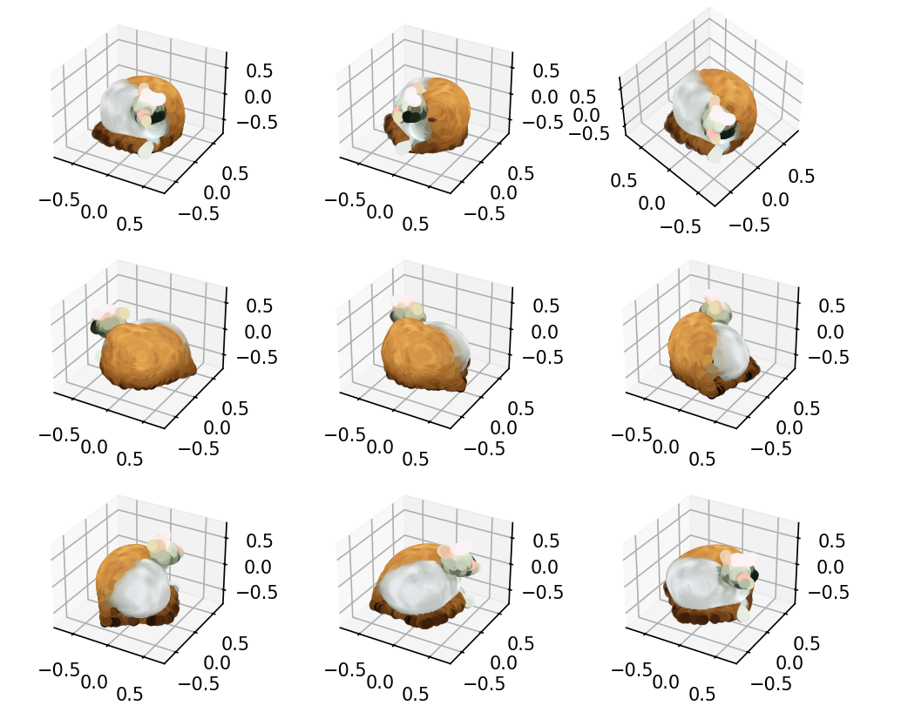
Visualizing Data
Show the generated point cloud:
A new figure is created using plt.figure().

Slide 9
Point-E Point Cloud Diffusion for 3D Model Synthesis
https://github.com/openai/point-e
From OpenAI
Used for 3D model generation with text-to-3D or image-to-3D
Generates point clouds from input
Consumer friendly
Does not require a powerful GPU
Relatively fast generation time
Simple
DEMO:
https://colab.research.google.com/drive/1f_3eQUUAodyRd3OMnOHyA7bltQrmBsqc

Slide 10
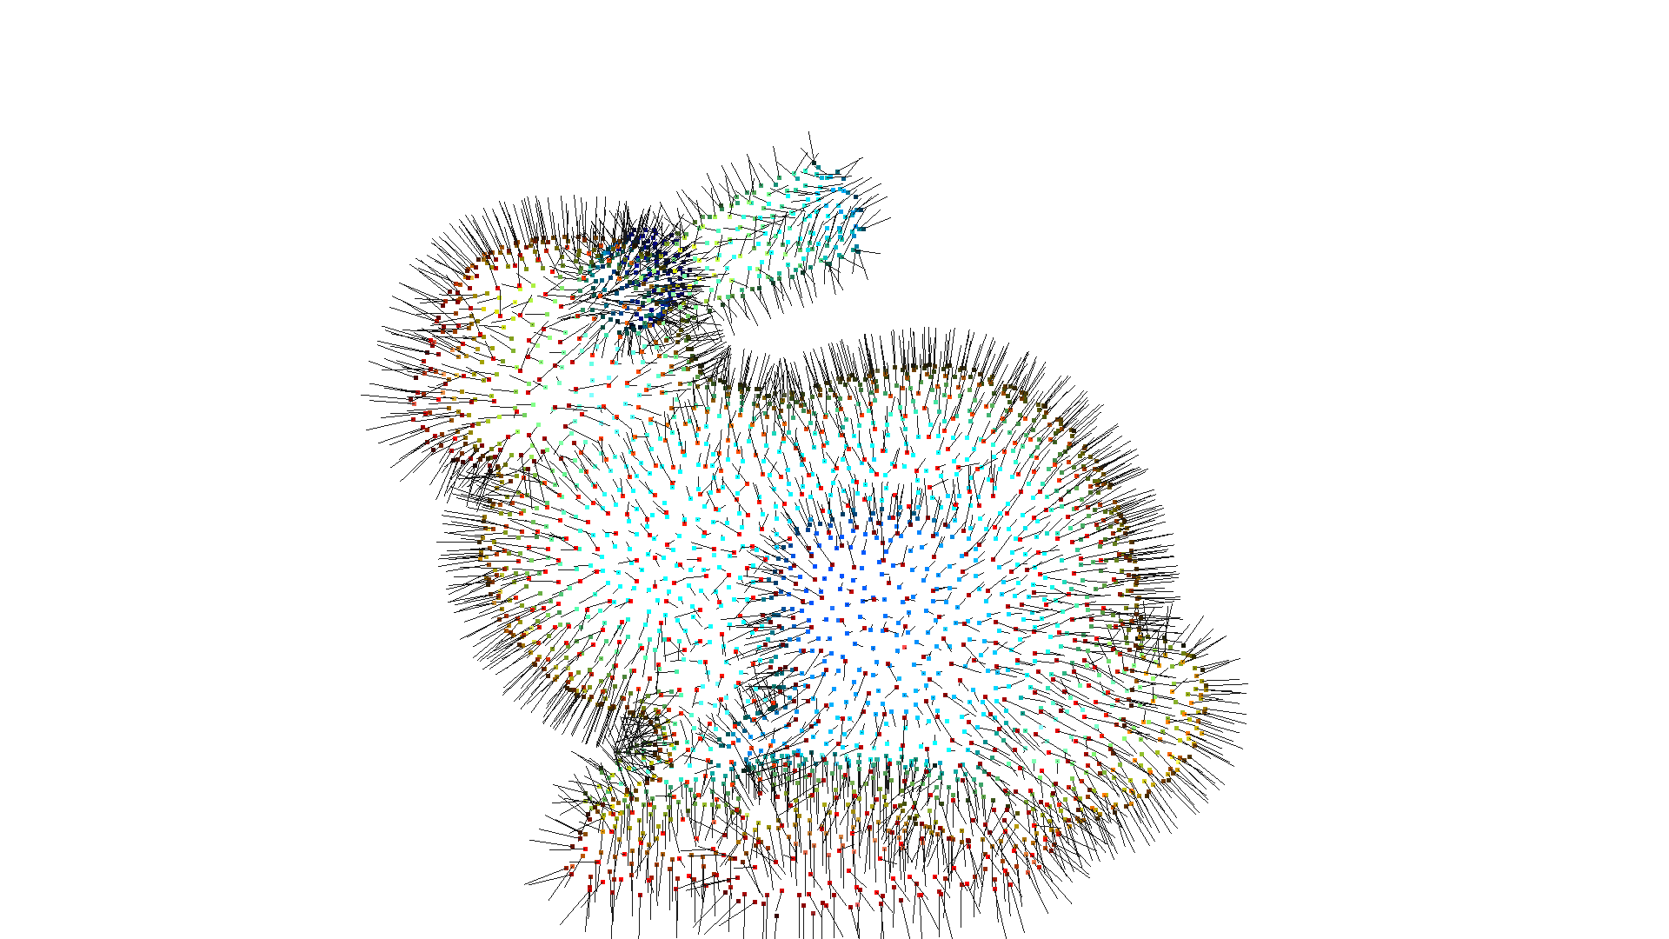
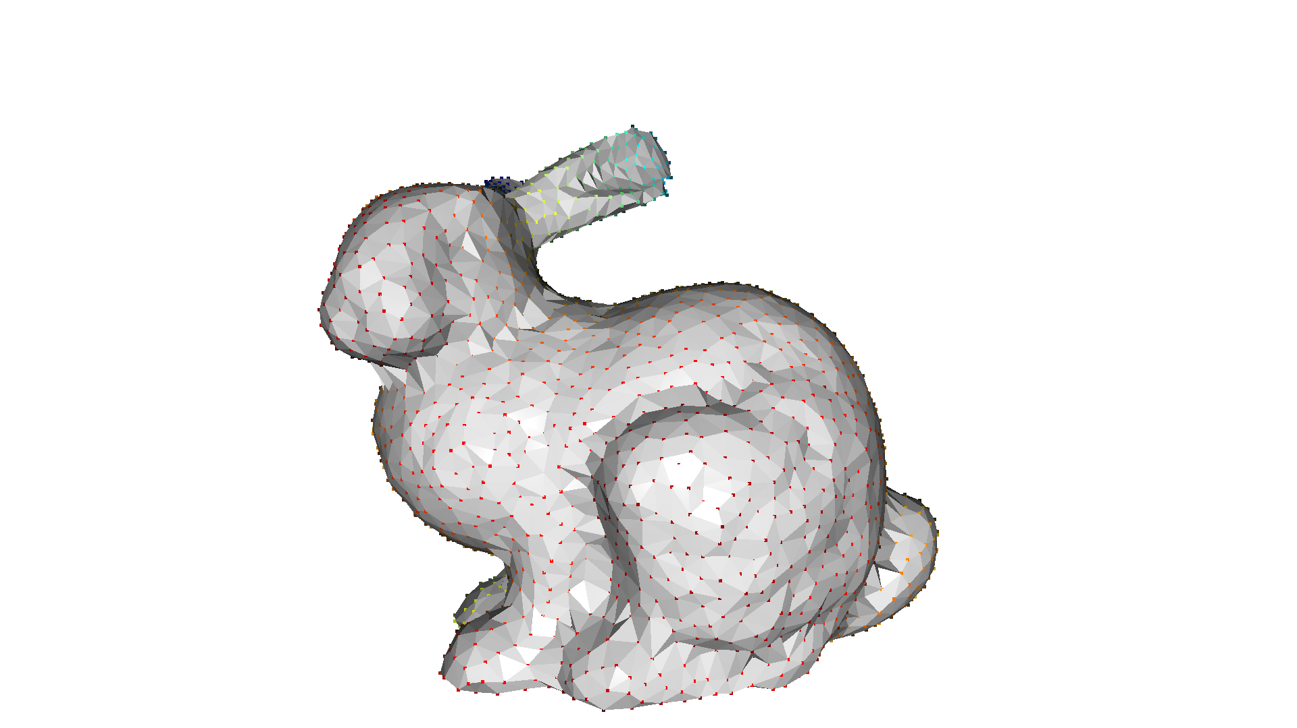
Open3D
Surface reconstruction using the ball pivoting method
Surface reconstruction is a way to generate a 3D geometry for a triangle mesh by estimating the surface (skin) from an unstructured point cloud

Slide 11
Other 3D Generation Models
NVIDIA GET3D:
https://research.nvidia.com/labs/toronto-ai/GET3D/assets/paper.pdf
https://research.nvidia.com/labs/toronto-ai/GET3D/
Github Repo:
https://github.com/nv-tlabs/GET3D
Linux recommended
High-end NVIDIA GPUS
3DFY
https://3dfy.ai/

Slide 12
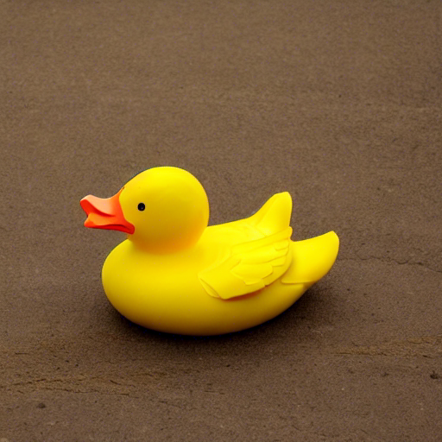
Example 1: Rubber Duck
Stable diffusion prompt used: a rubber duck, blank background

Slide 13
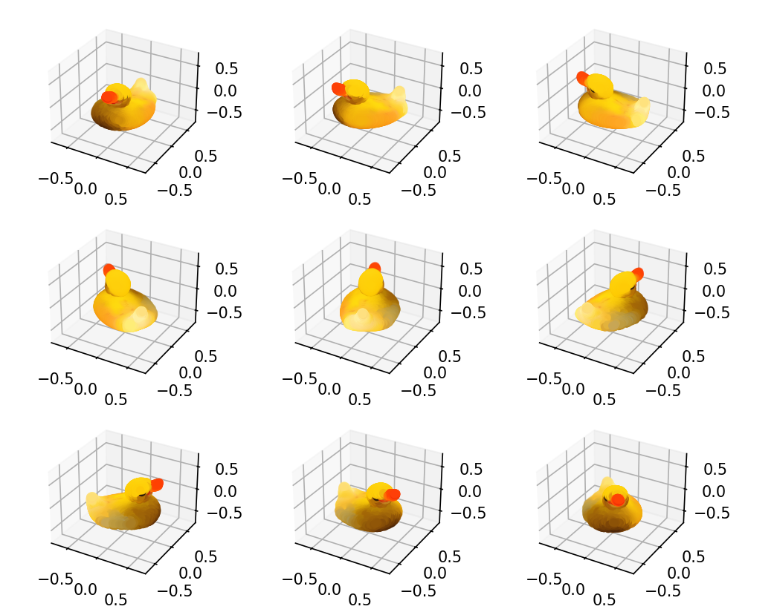
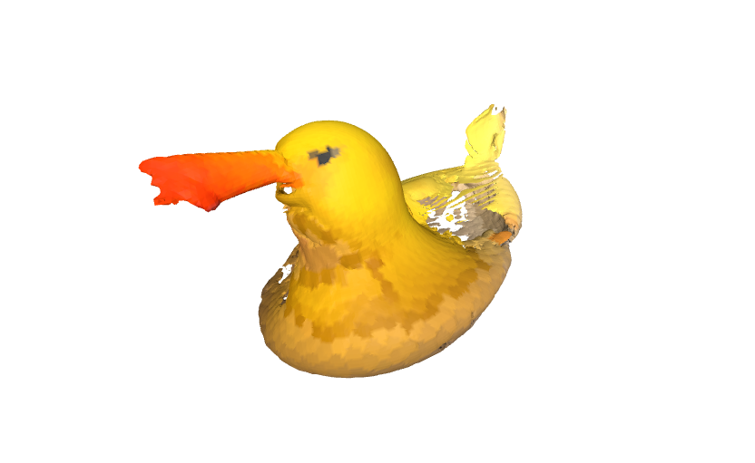
Example 1: Rubber Duck
Stable diffusion prompt used: a rubber duck, blank background

Slide 14
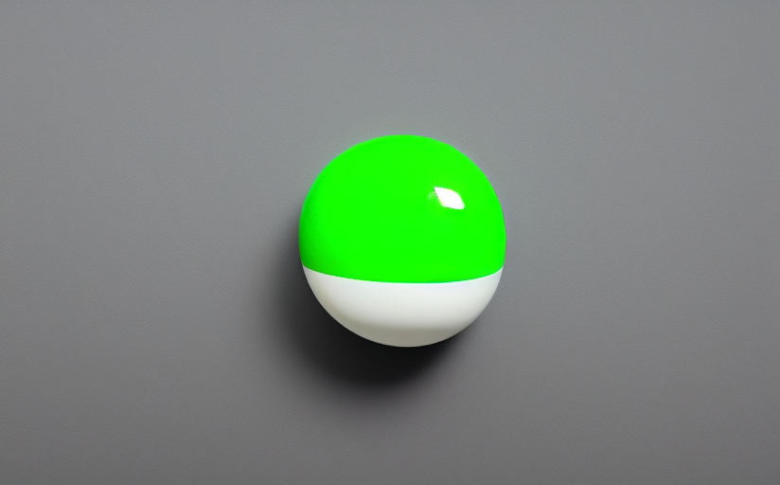
Example 2: Green Sphere
Stable diffusion prompt used: a green sphere, white background, centered

Slide 15
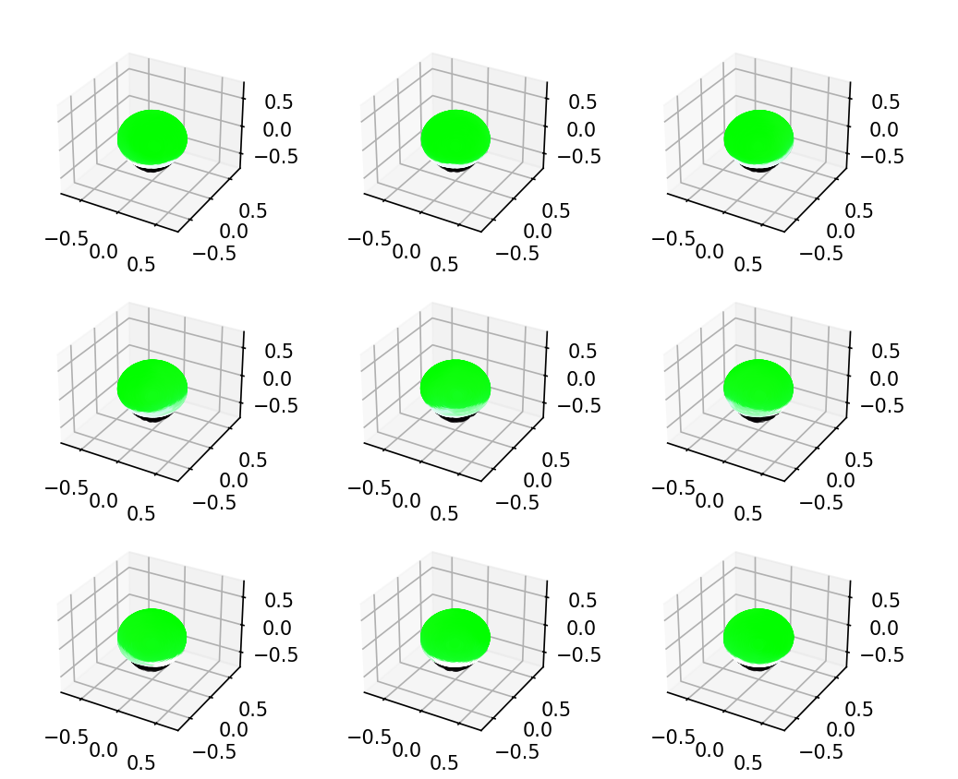
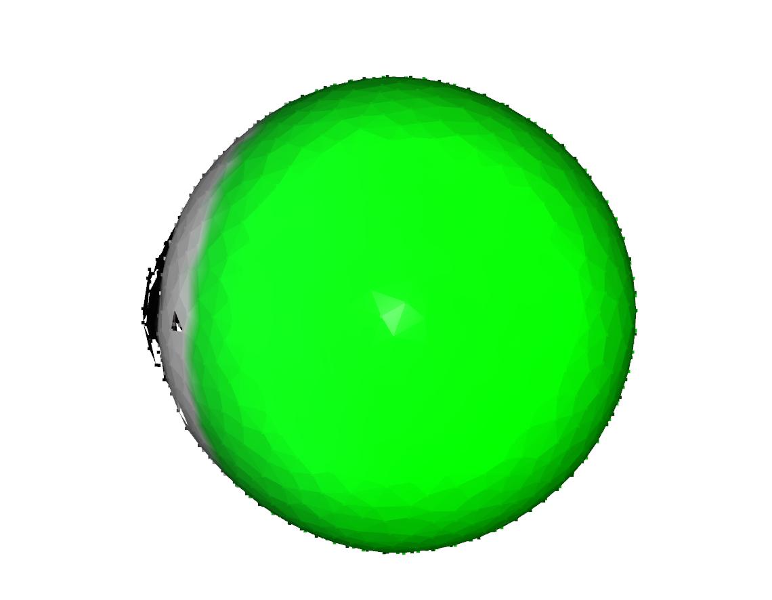
Example 2: Green Sphere
Stable diffusion prompt used: a green sphere, white background, centered

Slide 16

Example 3: House
Stable diffusion prompt used: a small house, white background

Slide 17
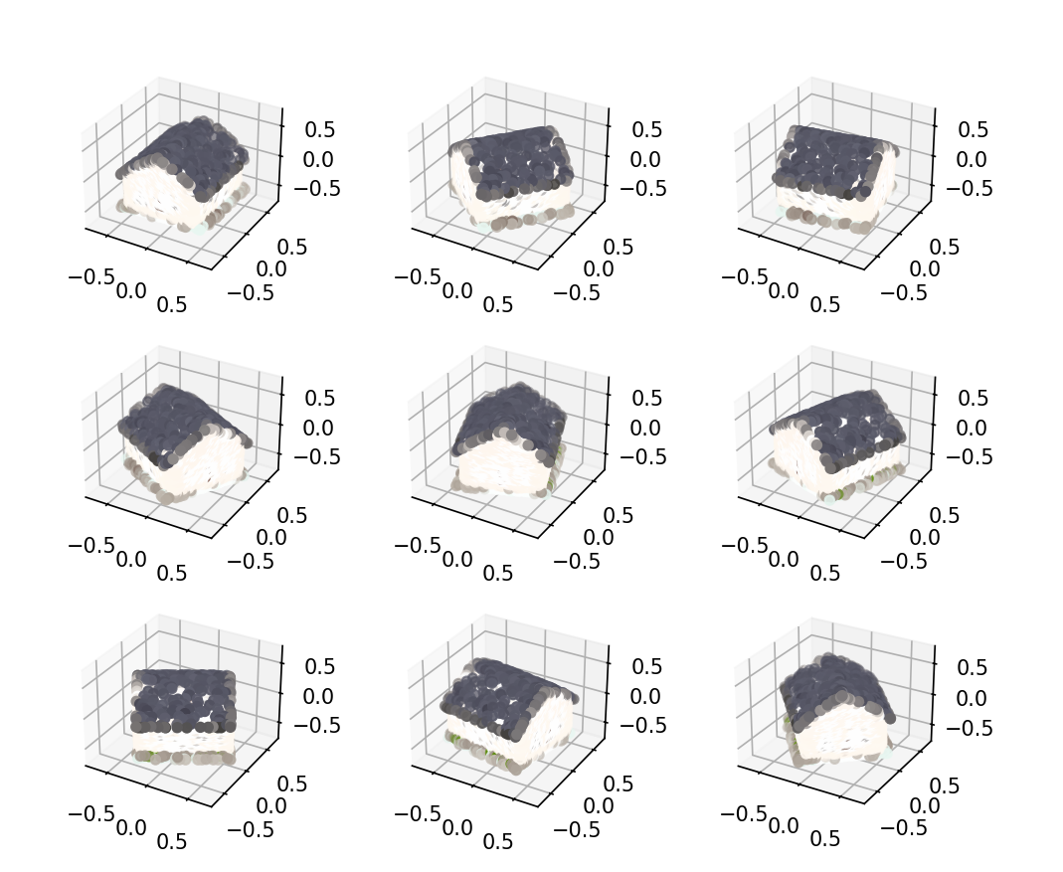
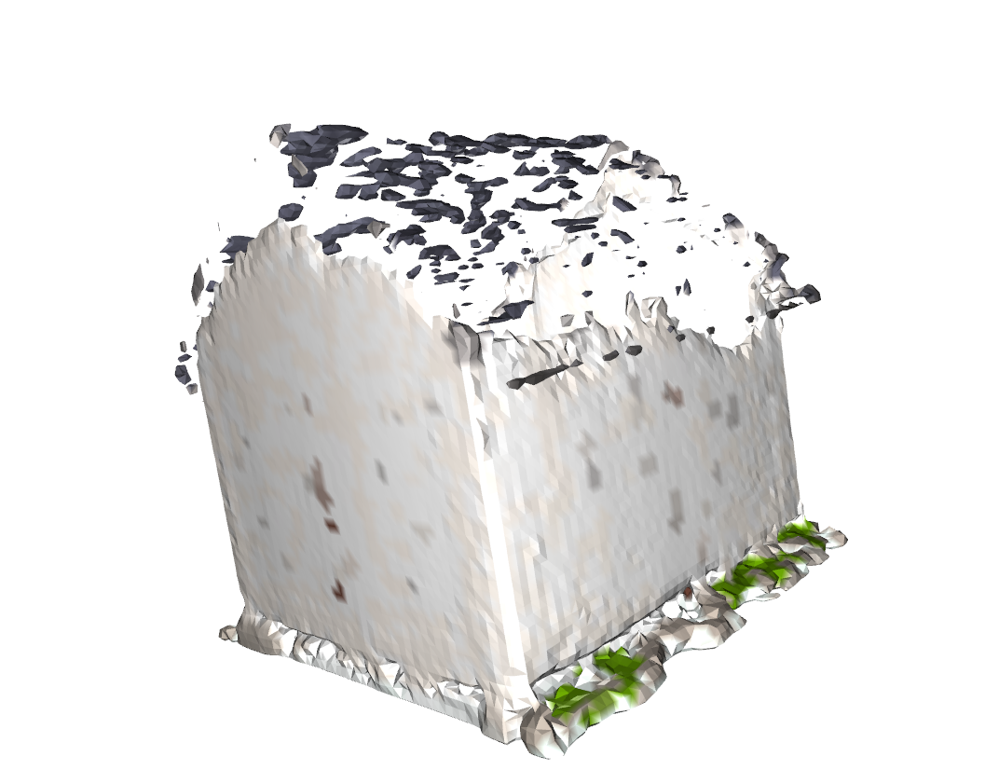
Example 3: House
Stable diffusion prompt used: a small house, white background

Slide 18
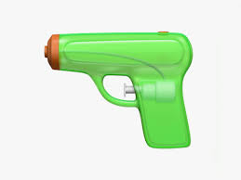
Example 4: Custom Image
“gun” emoji

Slide 19
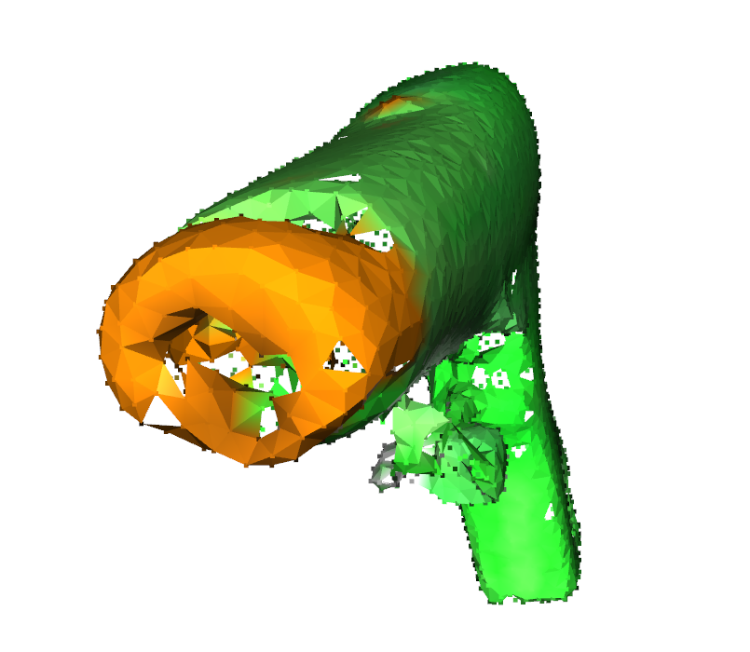
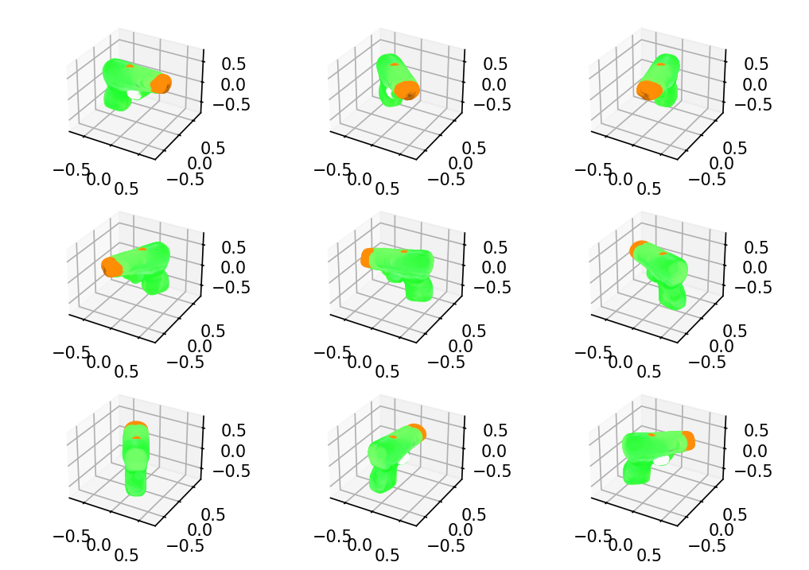
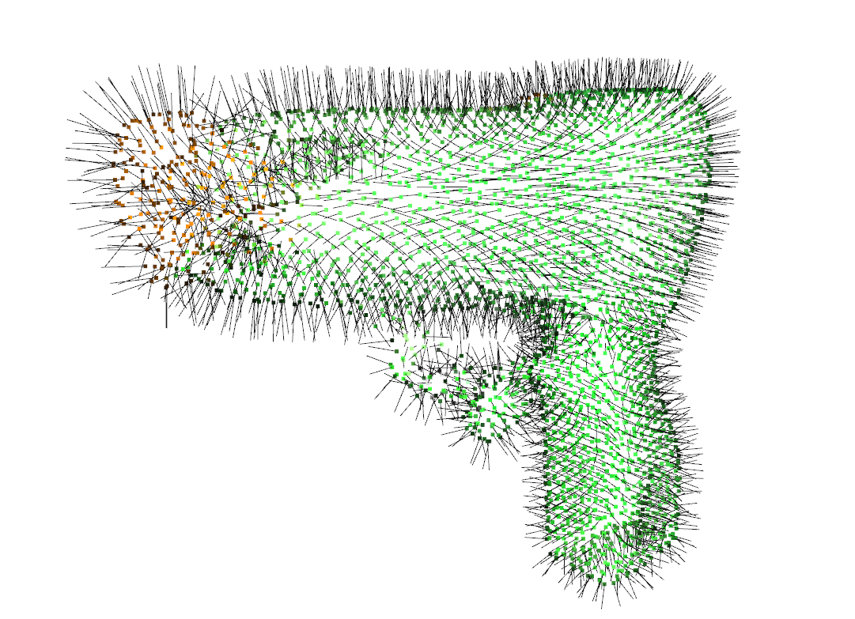

Slide 20


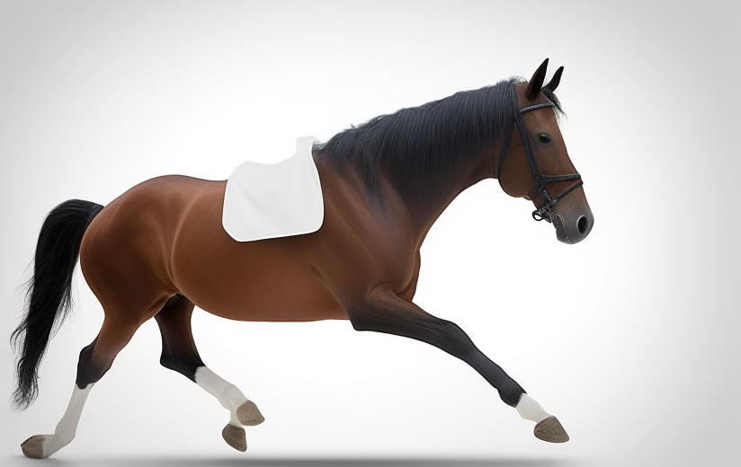

Testing Images

